Slide 1
Let’s Build an
Alexa Skill

Slide 2
Alexa Skills?
Applications for Alexa
Voice driven abilities to enhance your appliance and bring it to life

Slide 3
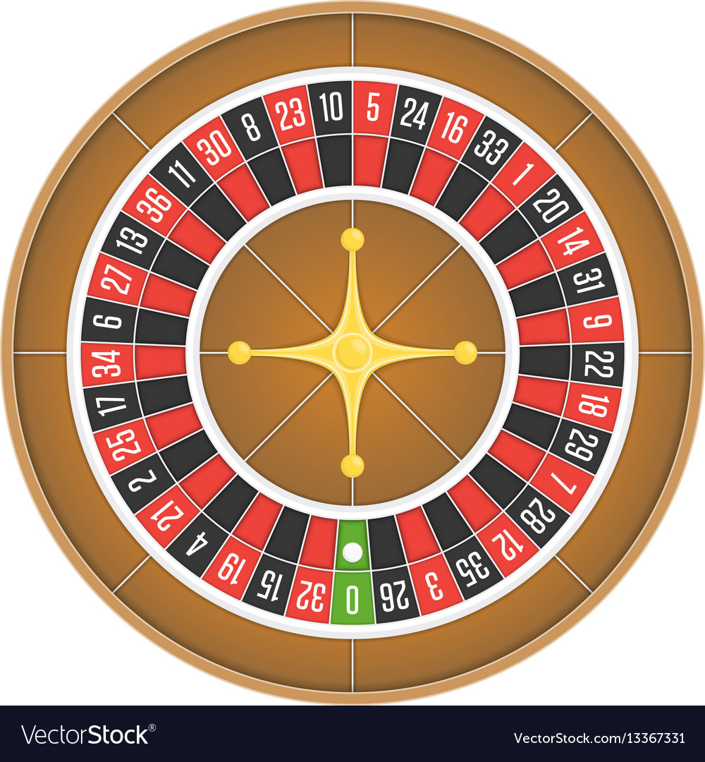
What is Roulette?
Roulette Skill
Game of chance
Spin the wheel and drop the ball betting on where it lands
We will be implementing bets by number, color and even vs odd

Slide 4
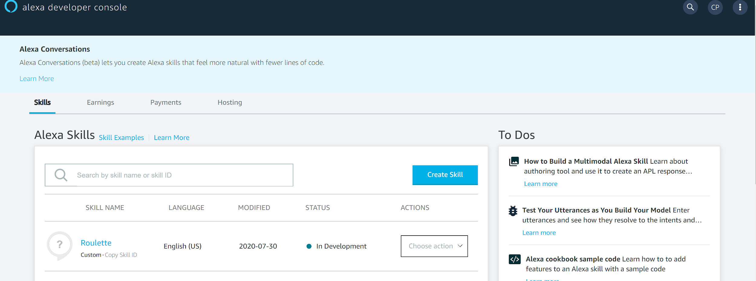
Alexa Developer Console

Slide 5
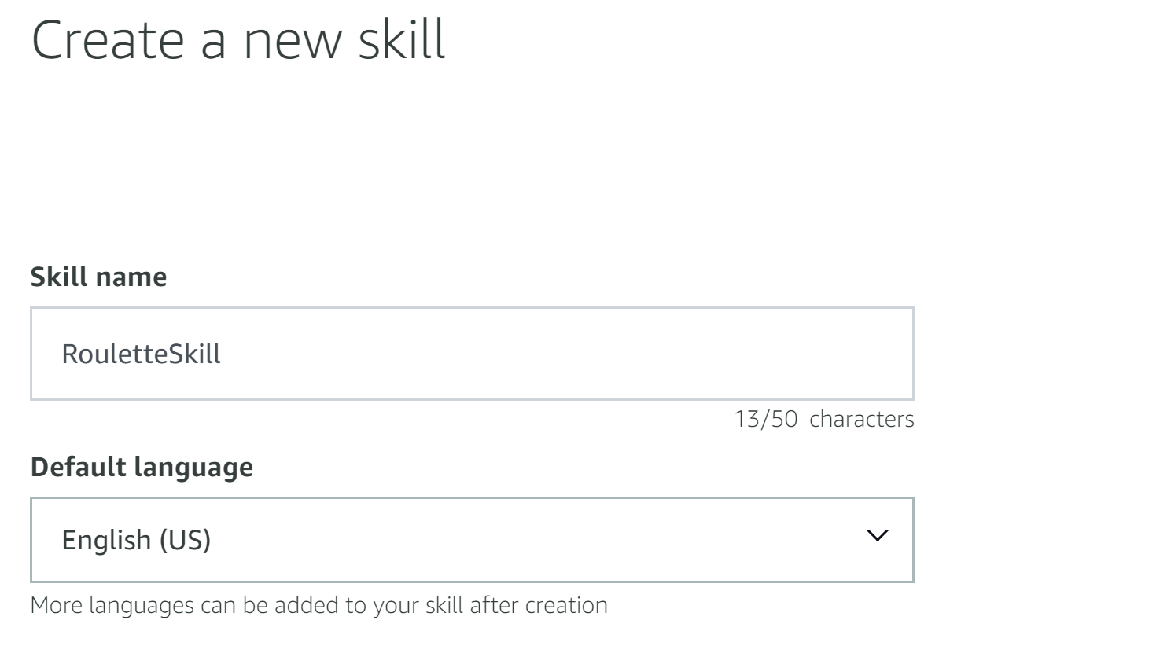
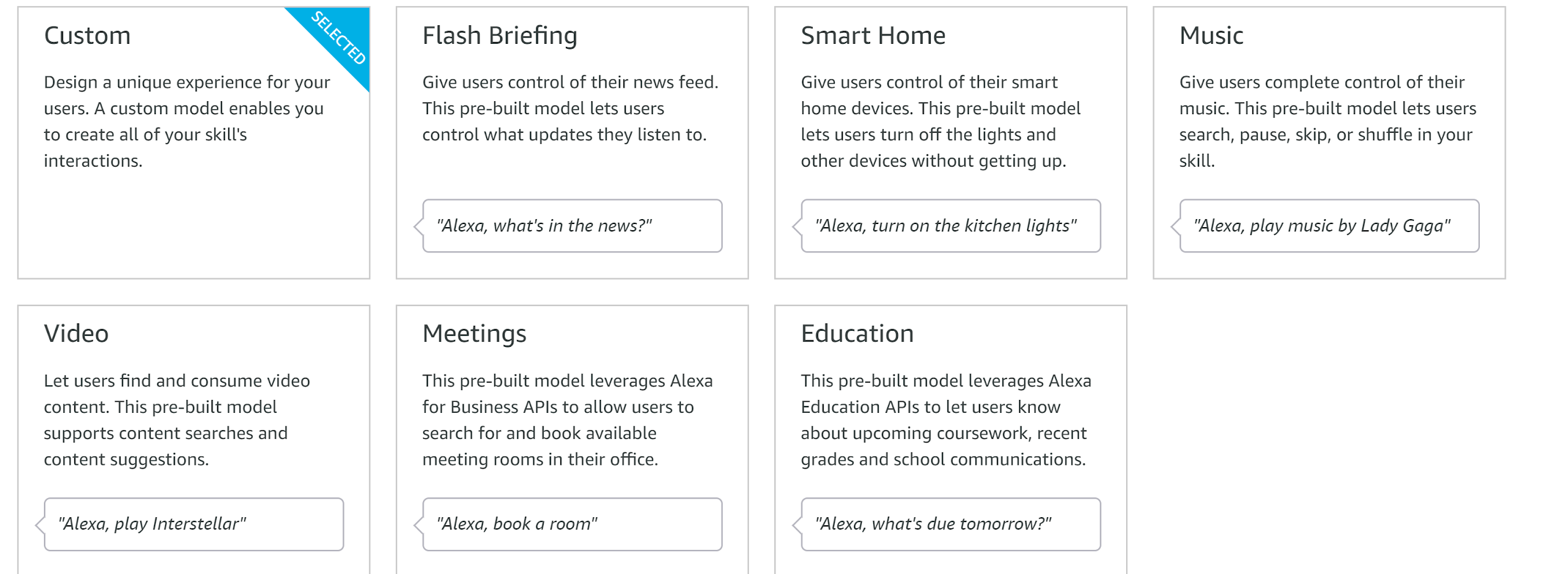
Create Skill

Slide 6
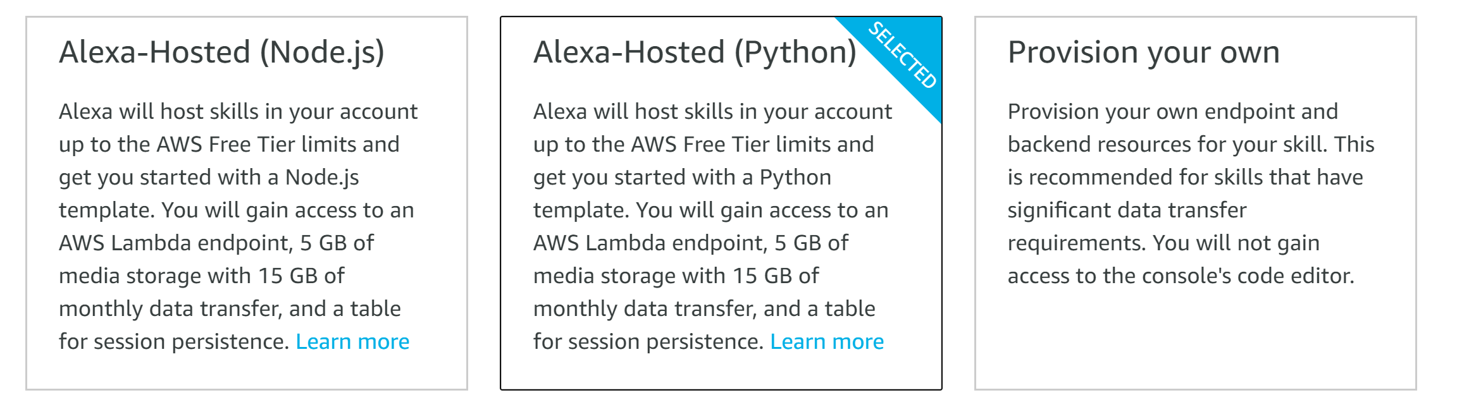
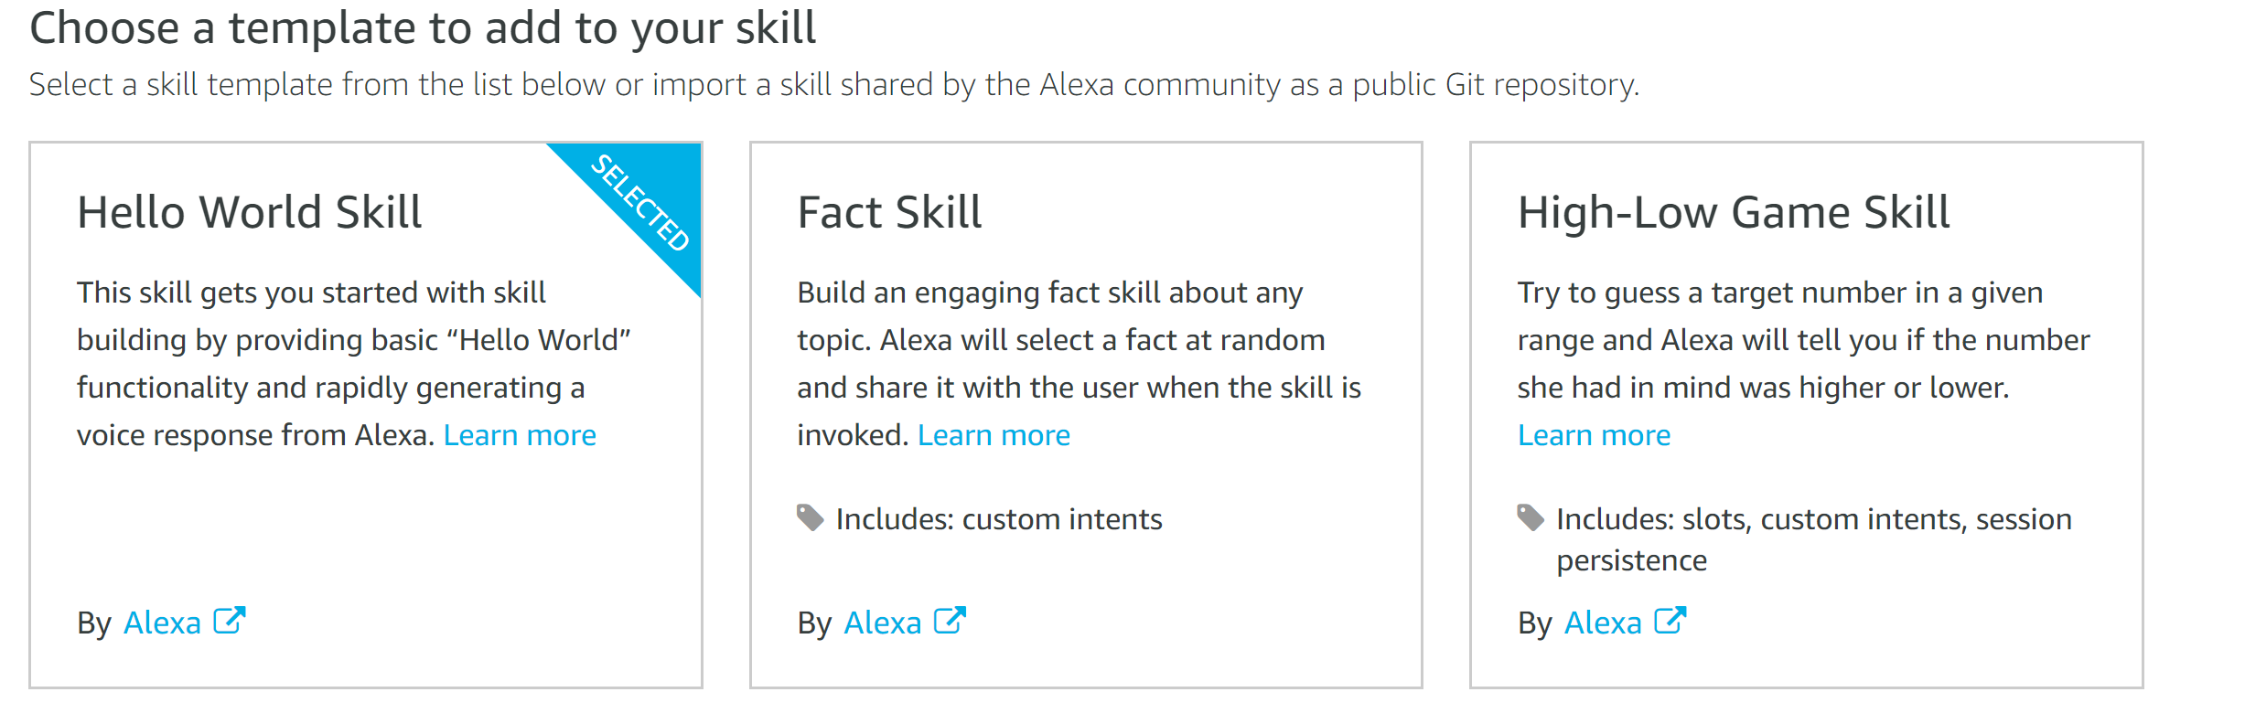
Skill Settings

Slide 7
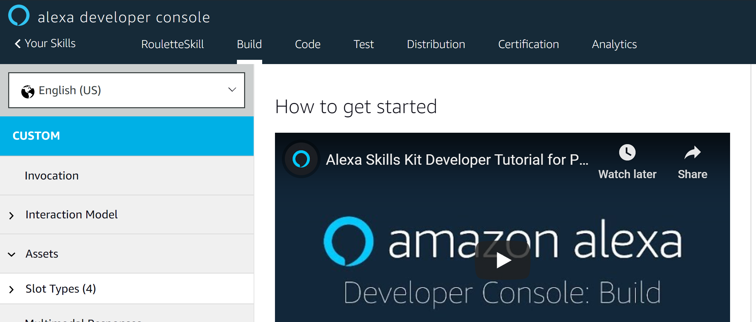
Alexa Developer Console

Slide 8
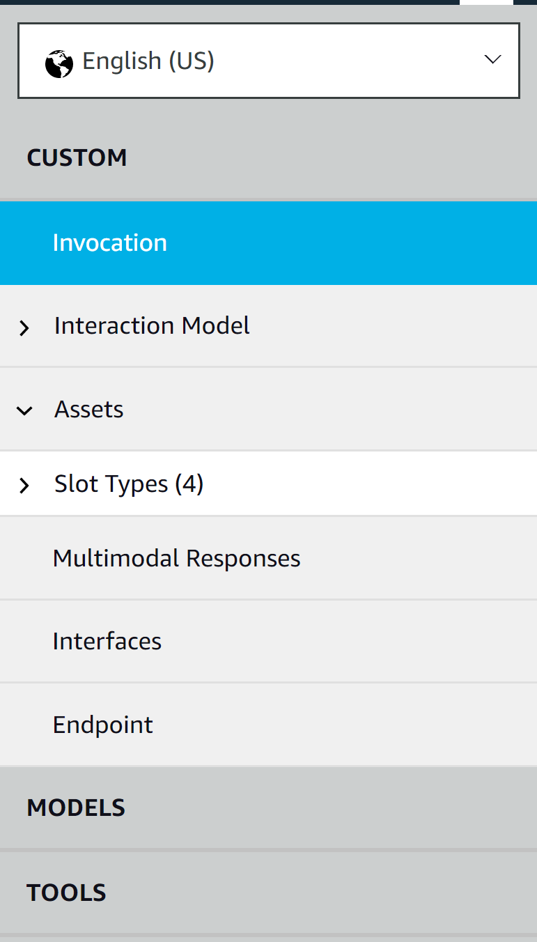
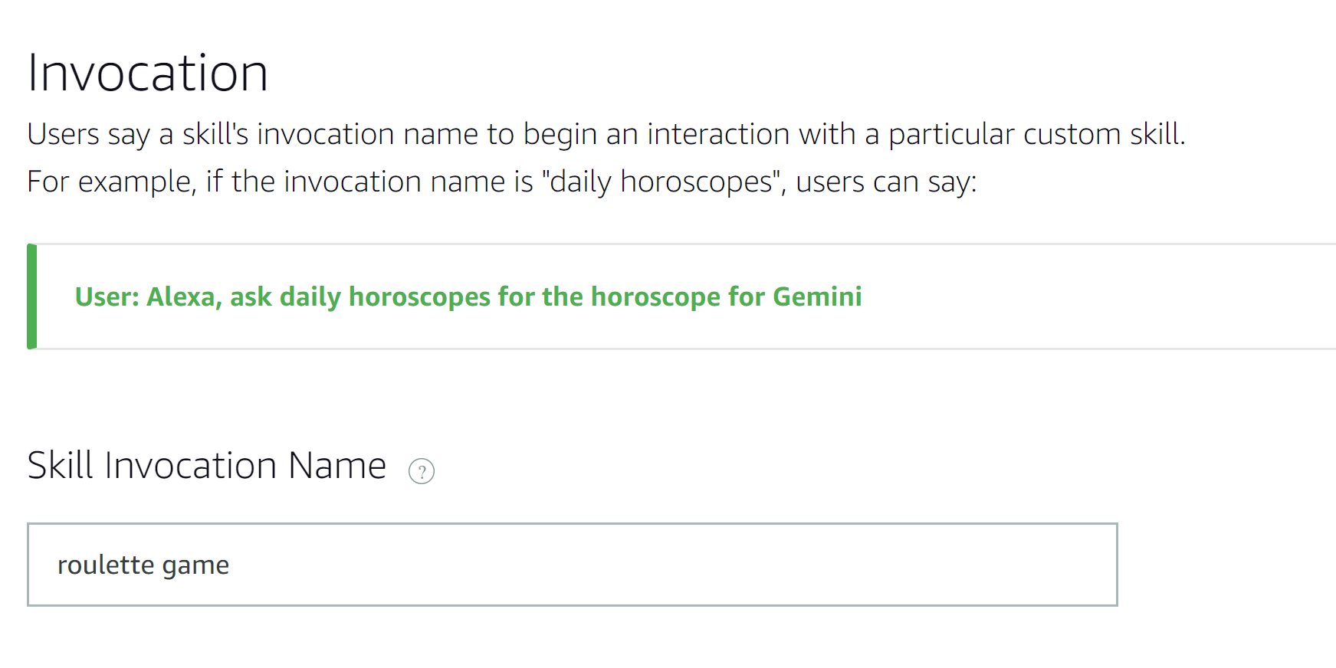
Beginning Interaction
Invocation

Slide 9
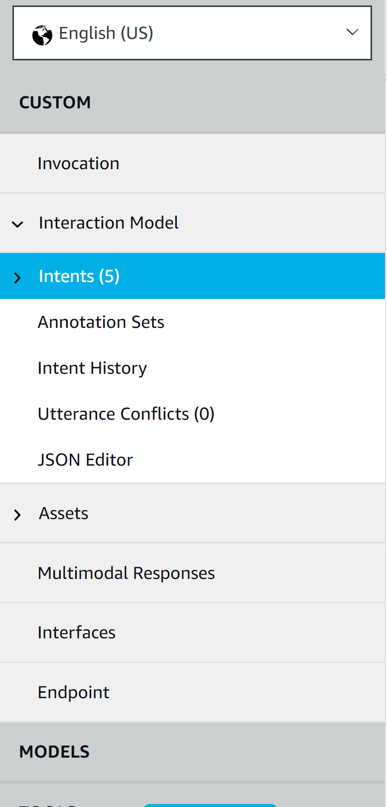
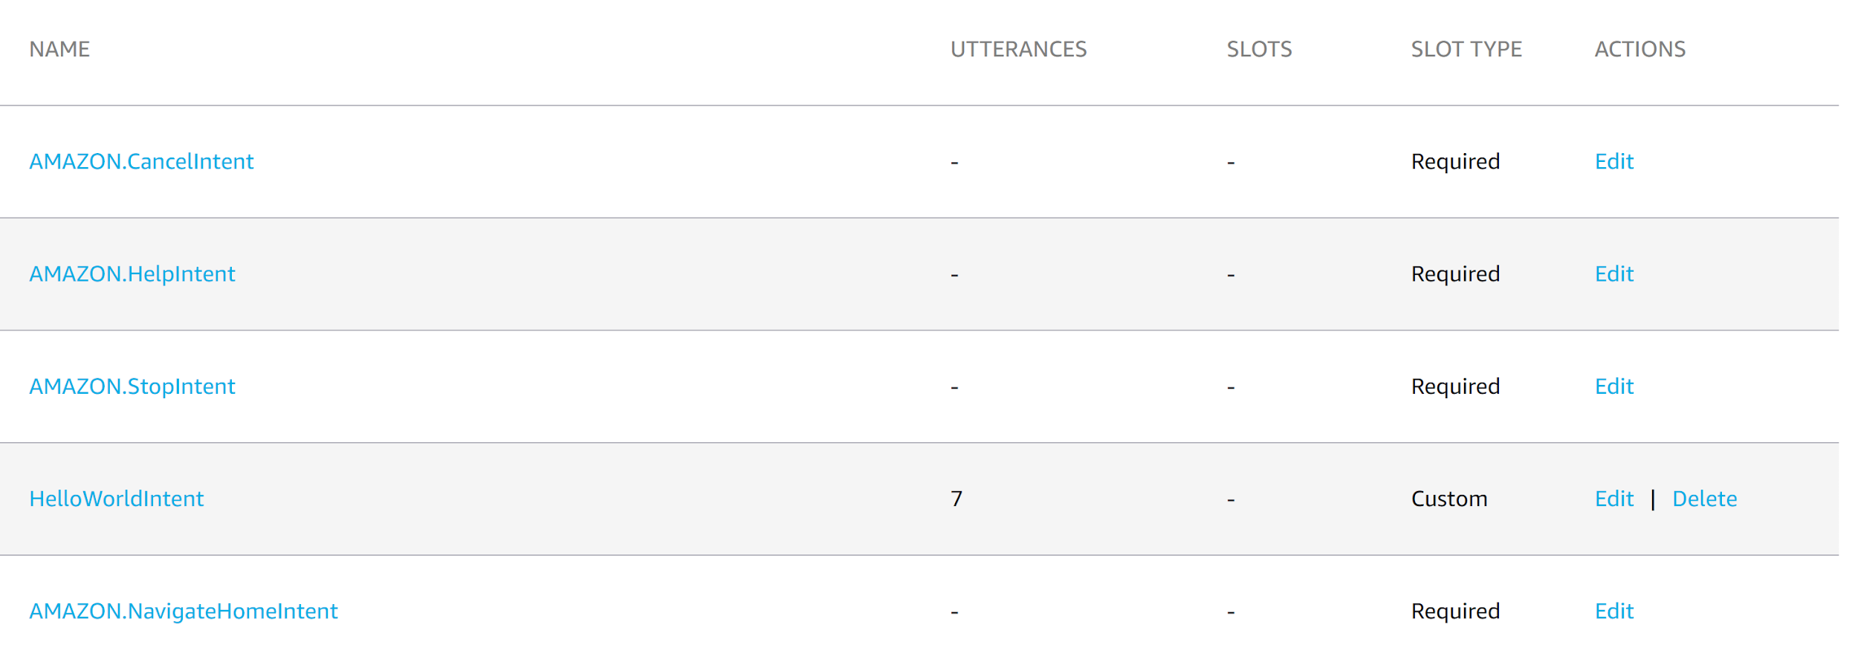
Core Functionality
Intents
Access Intents under the interaction model
Intent represents an action that fulfills a users spoken request
Intent’s optional arguments are called slots
Delete HelloWorldIntent
Notes:
Intent: An intent represents an action that fulfills a user's spoken request.

Slide 10
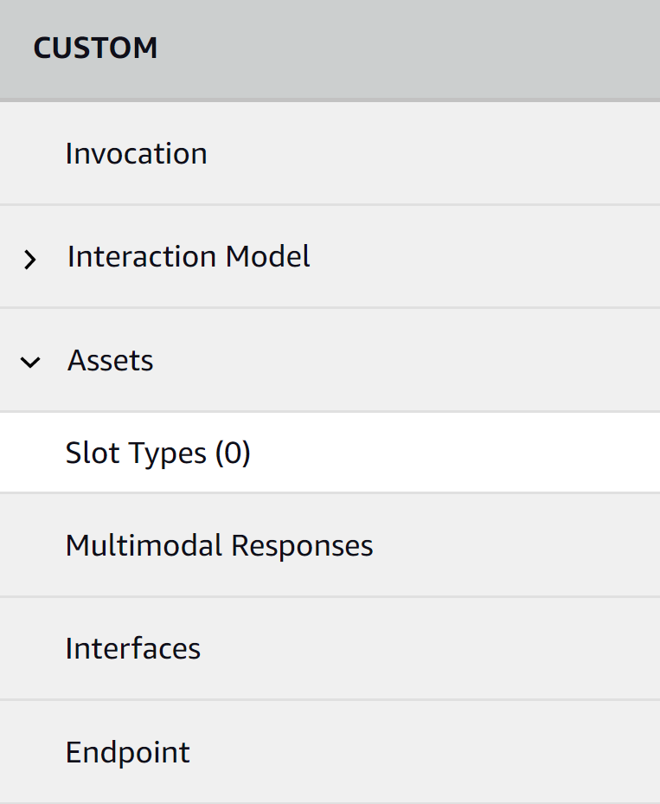
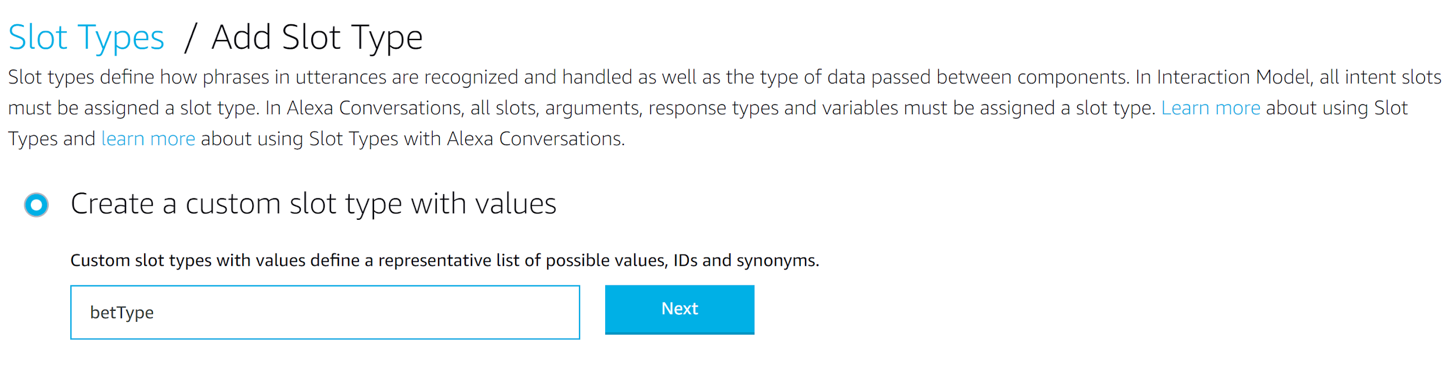
Variables for intents
Slots
Access Slots under Assets

Slide 11
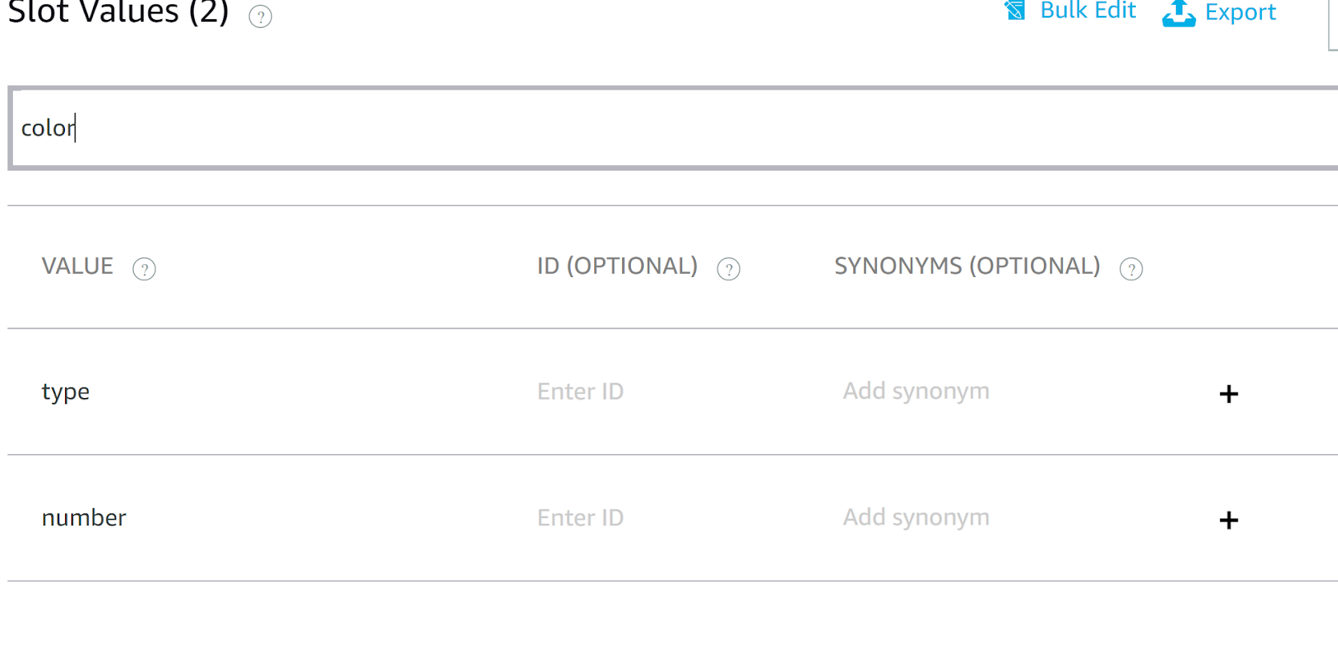
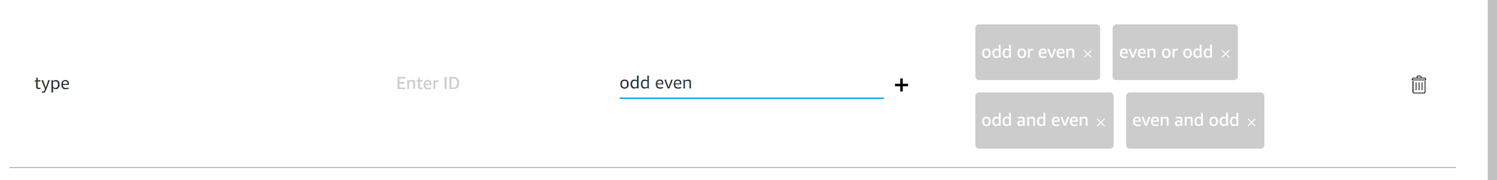
Creating First Slot
Slots
Notes:
Add synonyms

Slide 12
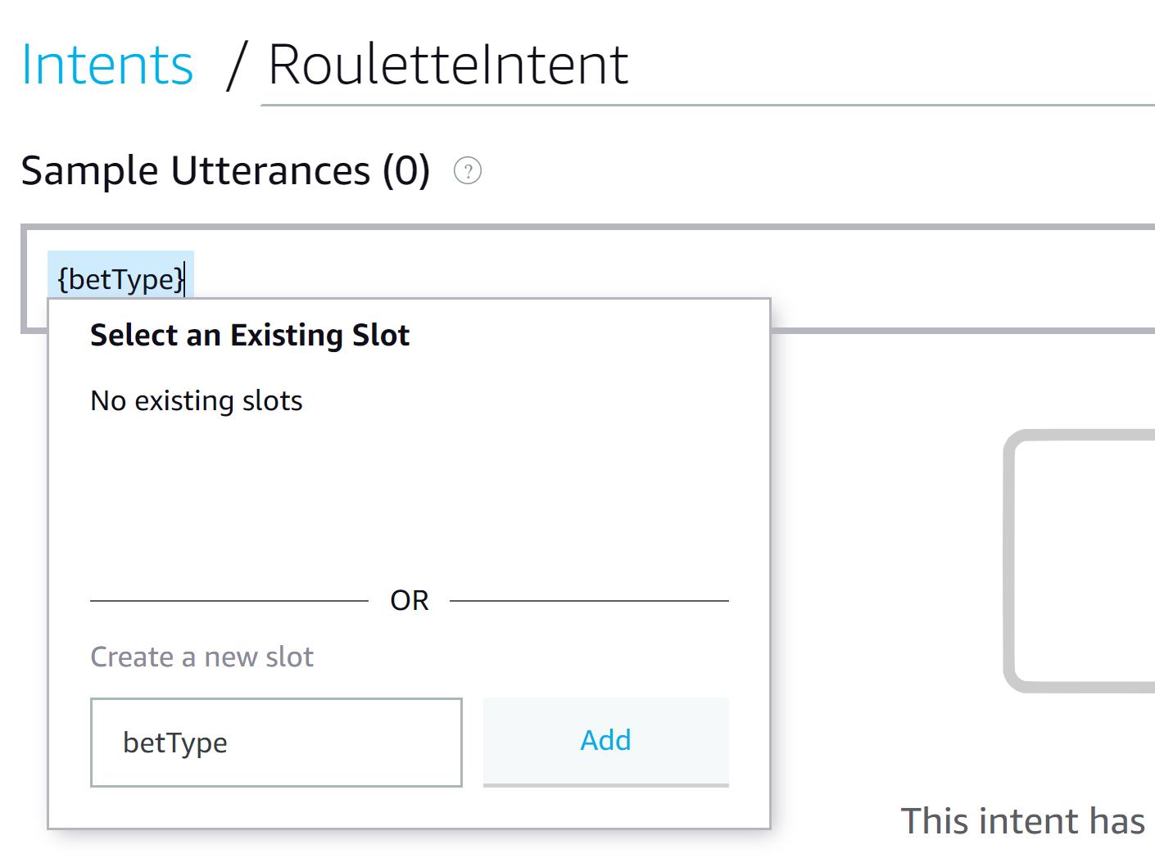
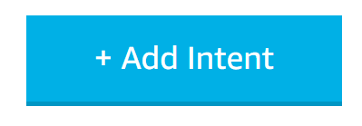
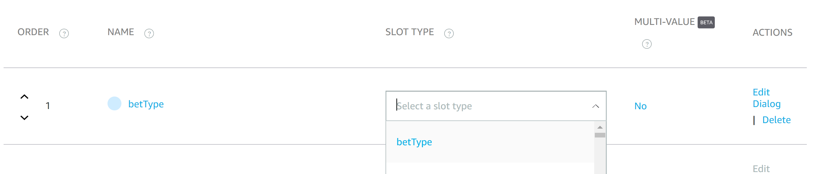
Adding your first intent
Intents
2)
1)
Add Intent “RouletteIntent”
Add a slot to your intent by adding text in {brackets}
Select corresponding slot type
3)

Slide 13
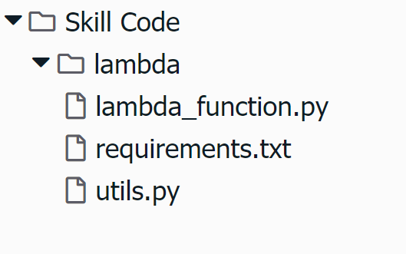
Beginning the backend
Code

Slide 14
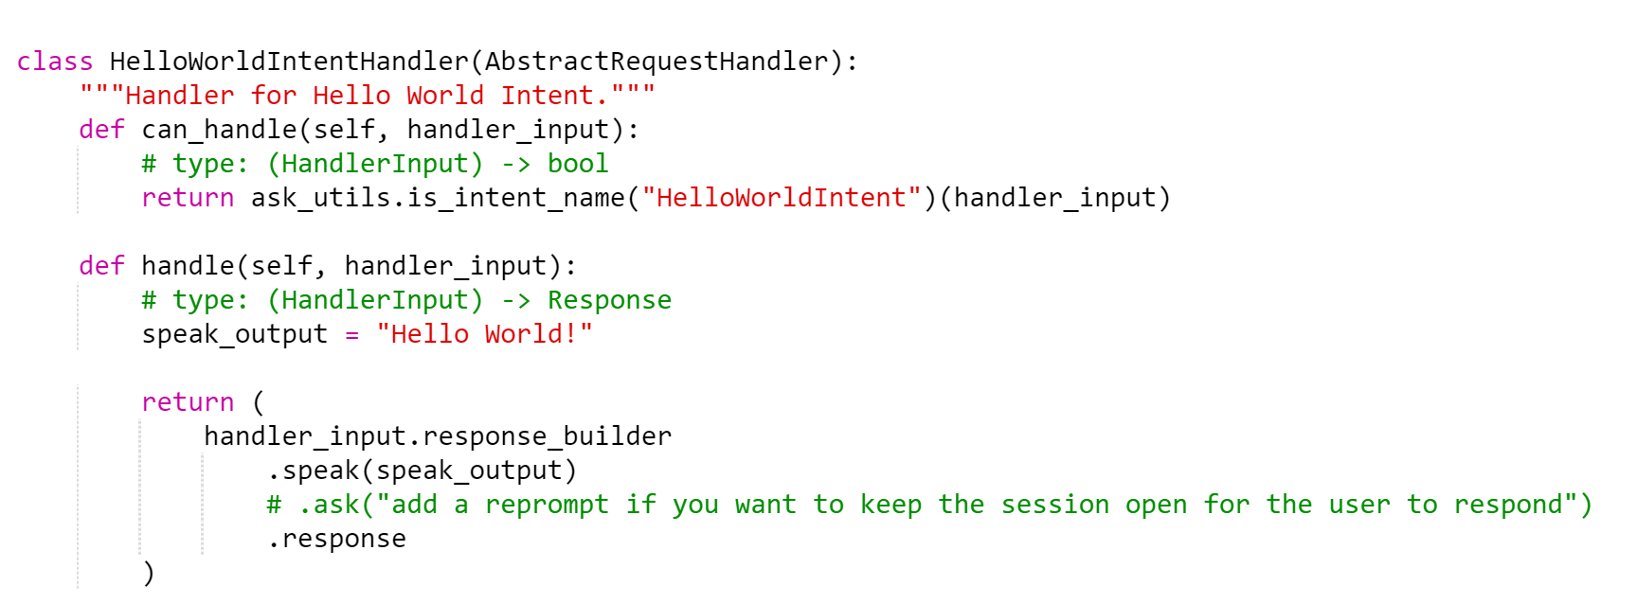
Code
Notes:
Sample intent handler to read over but you can delete this class because we will not be using it

Slide 15
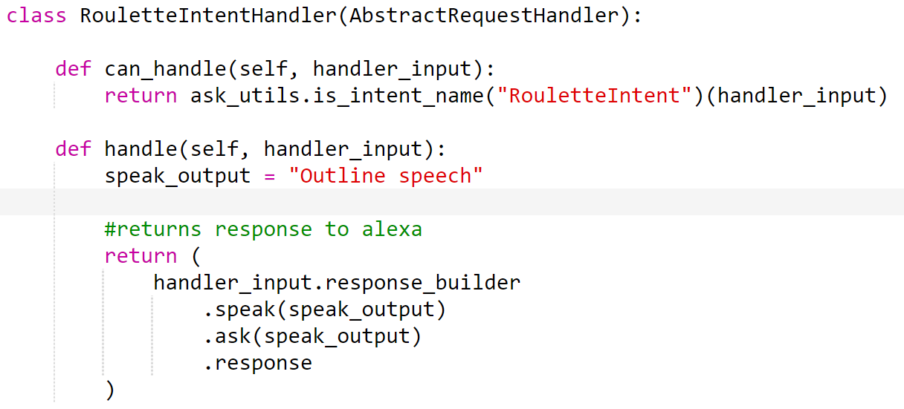
Intent Handler Outline
Notes:
This is the intent handler outline that we will be using.

Slide 16
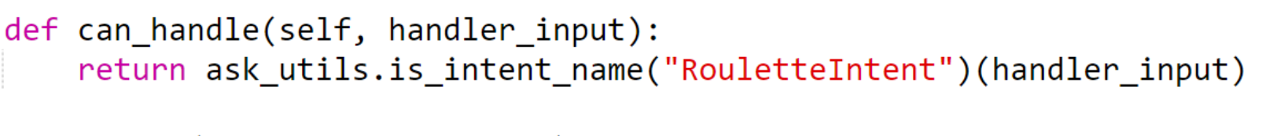
Intent Handler Outline
Can_handle function
Recognizes incoming requests
Function is triggered by keywords we assigned for the RouletteIntent
.is_intent_name() checks whether the named intent can handle the input
If handled correctly, function returns true and fuction “handle” is called
Notes:
recognizes each incoming request that Alexa sends. You use .is_intent_name() and pass in the name of the intent. This returns a predicate, which is a function object that returns True if the given handler_input originates from the indicated intent. If this is true, then the SkillBuilder object will call JokeIntentHandler.handle().

Slide 17
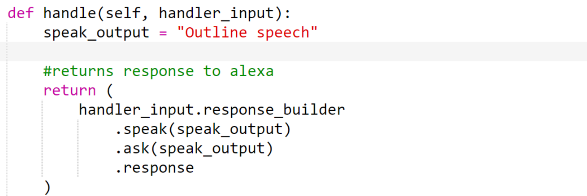
Intent Handler Outline
Handle Function
Returns appropriate response back to Alexa frontend
Speak_output is the variable that will be spoken back to the user
Notes:
returns an appropriate response

Slide 18
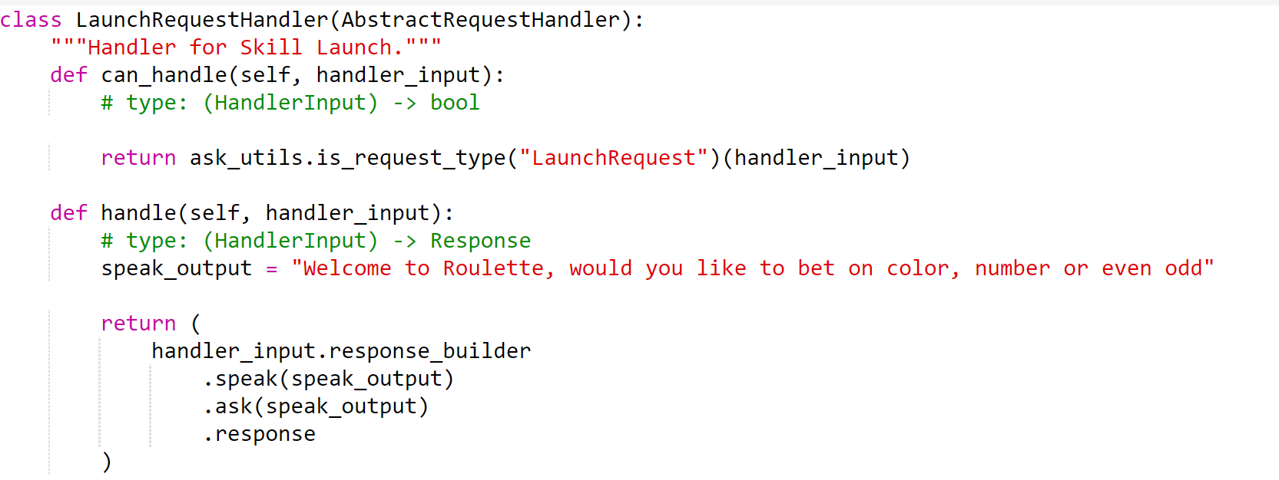
Launch Response
New launching output
Notes:
Change the speech output from Welcome, you can say Hello or Help. Which would you like to try?" to ^^^

Slide 19
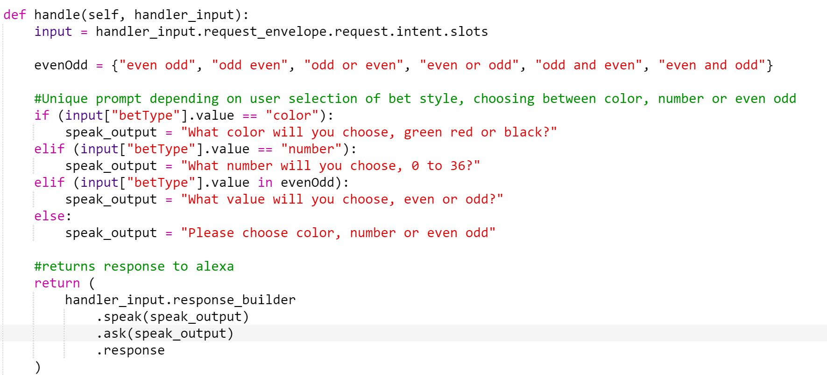
Roulette Handler
Notes:
Value: A string that represents the value the user spoke for the slot. This is the actual value the user spoke not necessarily the canonical value or one of the synonyms defined for the entity.

Slide 20
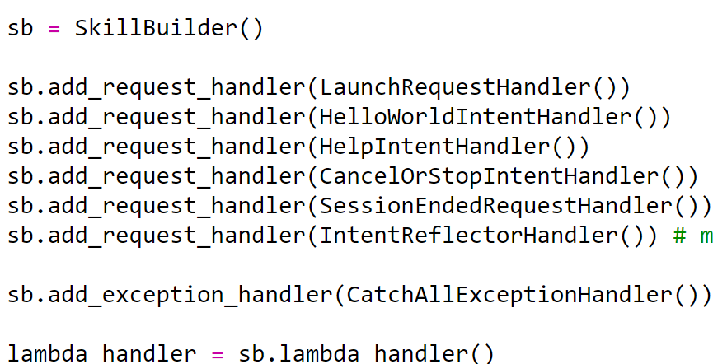
Add to the SkillBuilder

Slide 21
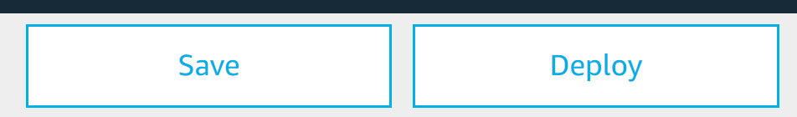
Save and Deploy

Slide 22
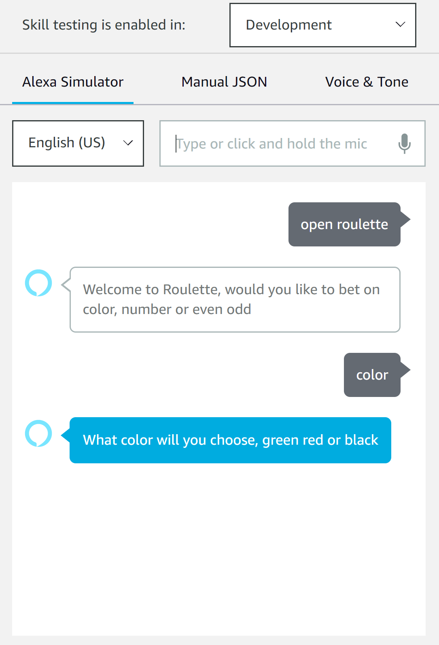
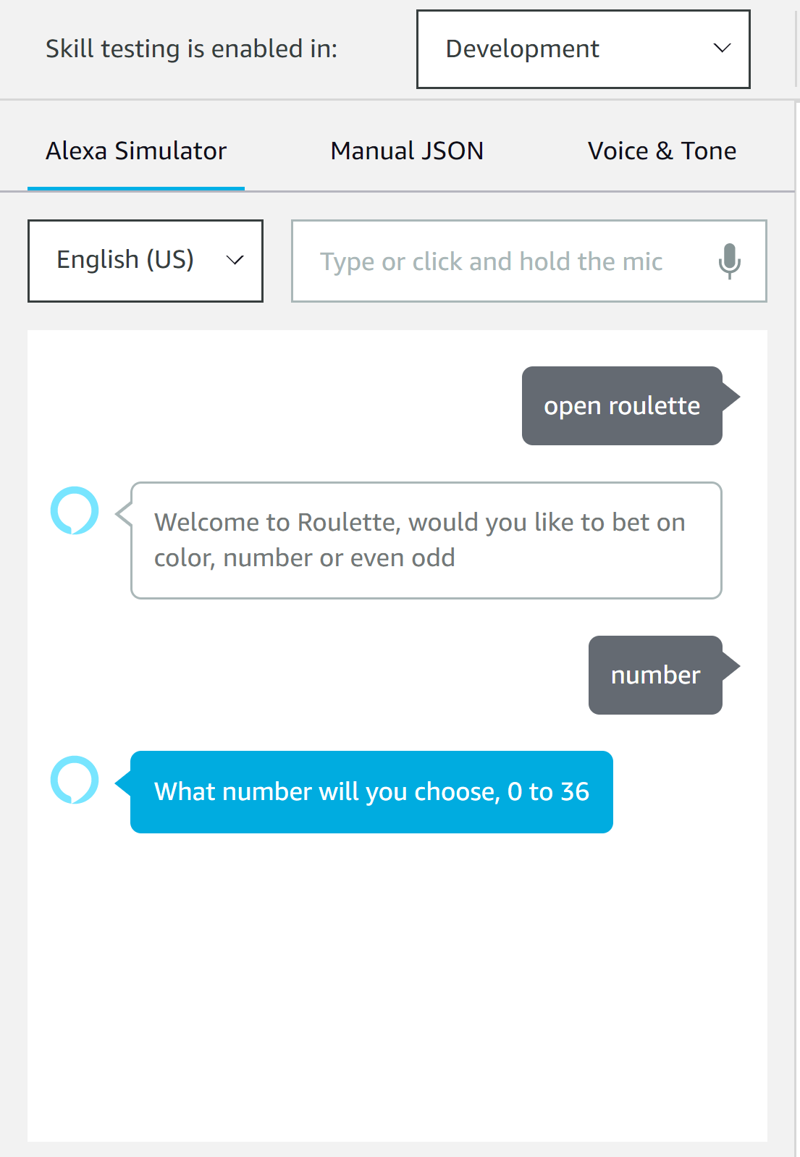
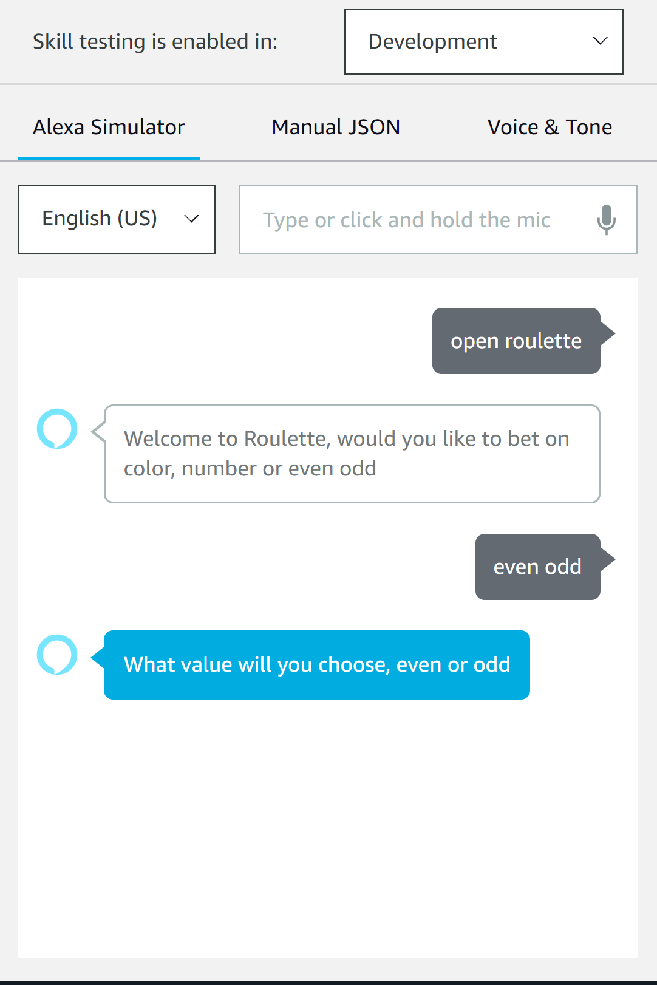
Testing

Slide 23
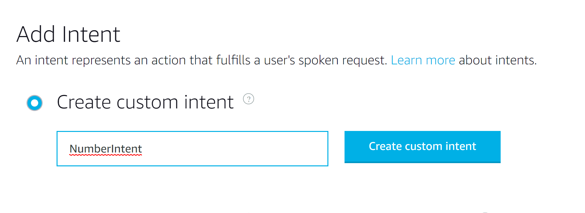
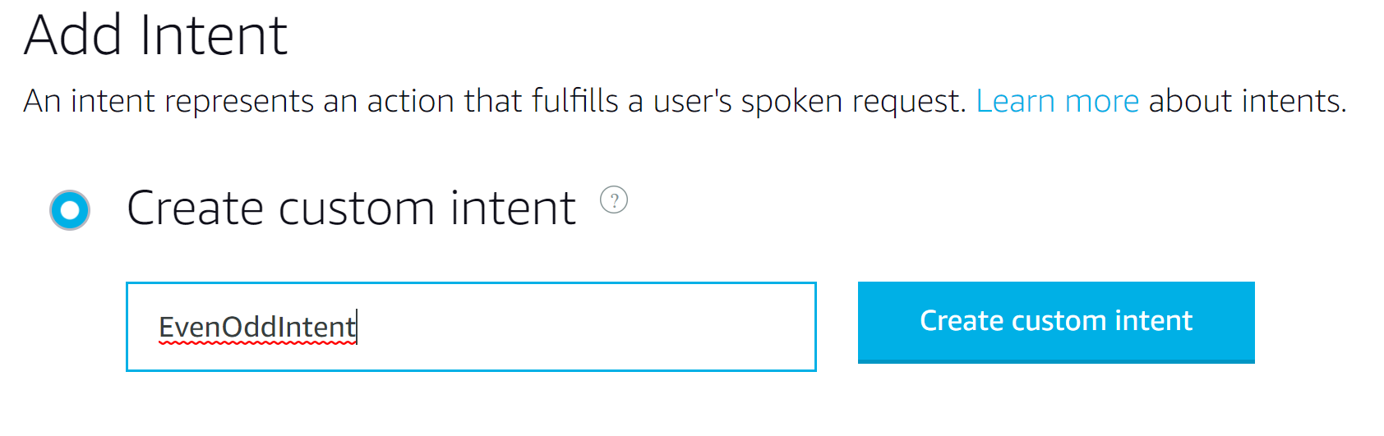
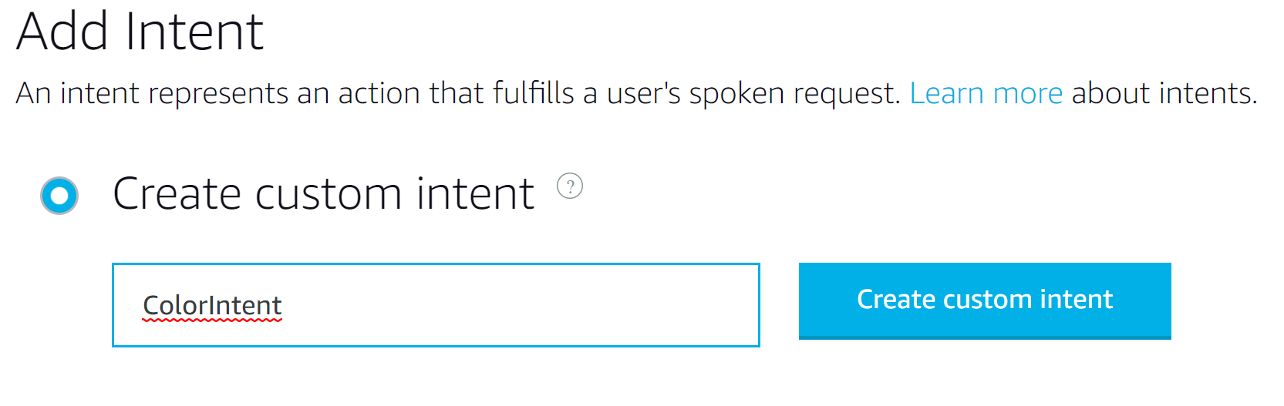
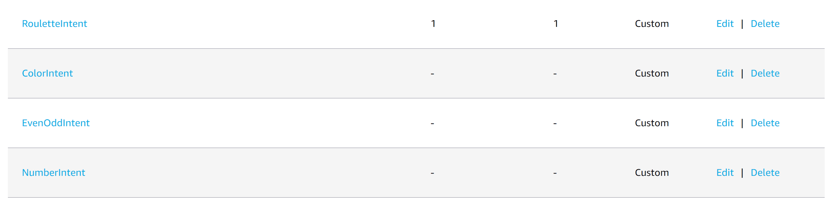
New Intents

Slide 24
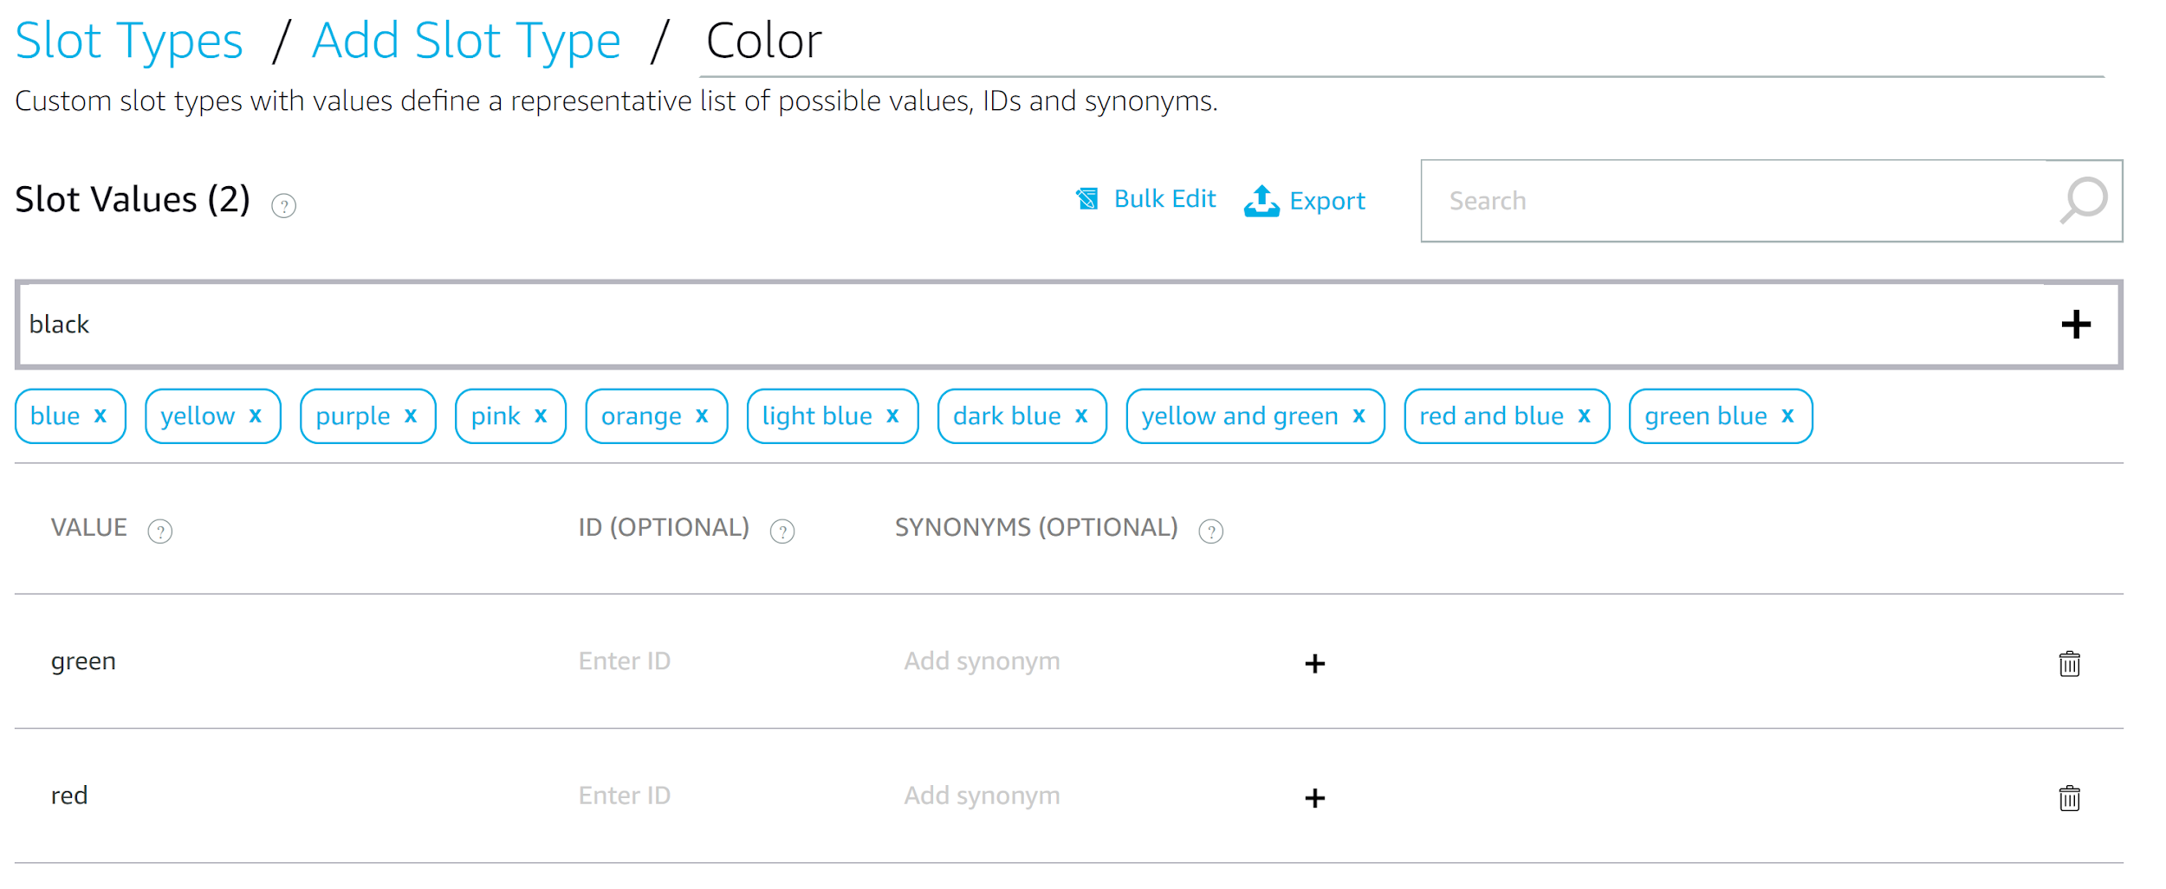
New slots

Slide 25
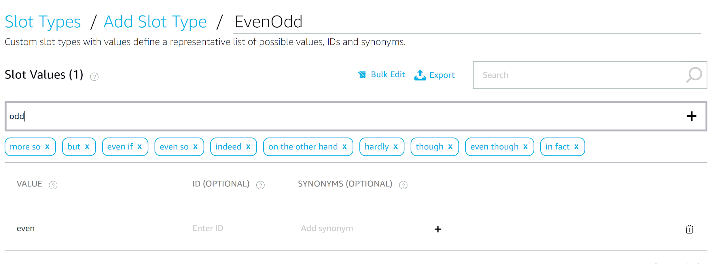
New Slots

Slide 26
New Slots
Existing Slot Types

Slide 27
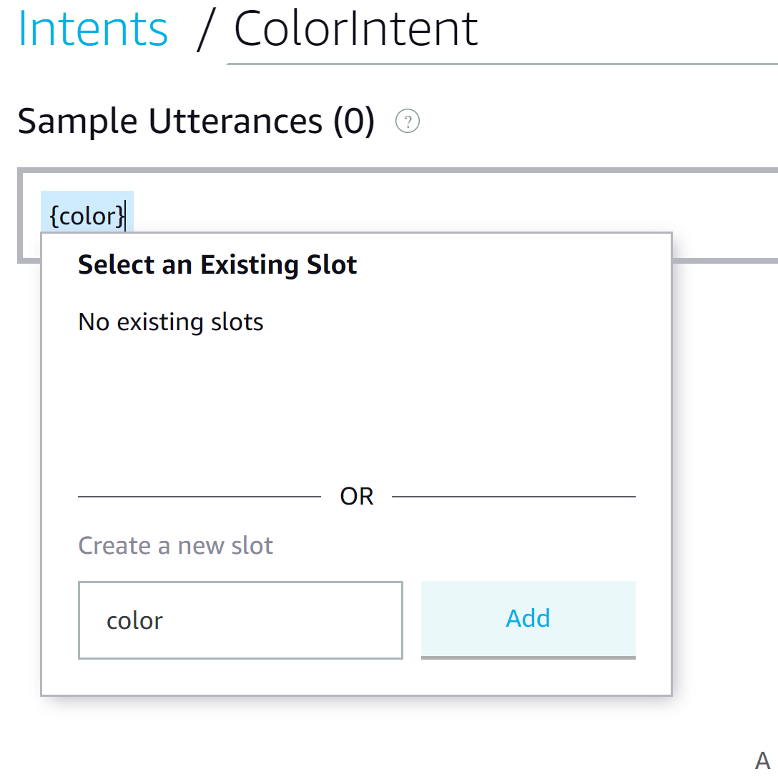
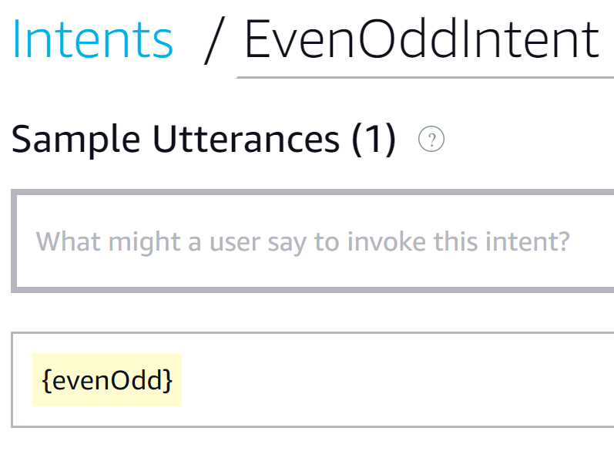
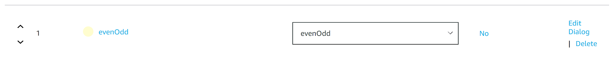
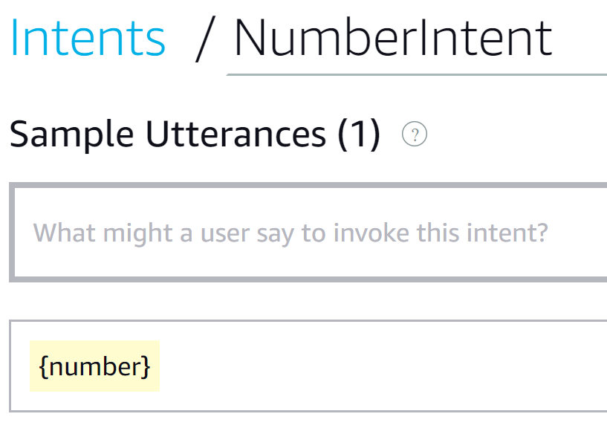
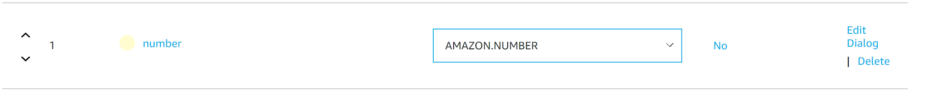
Add Slots to Intents

Slide 28
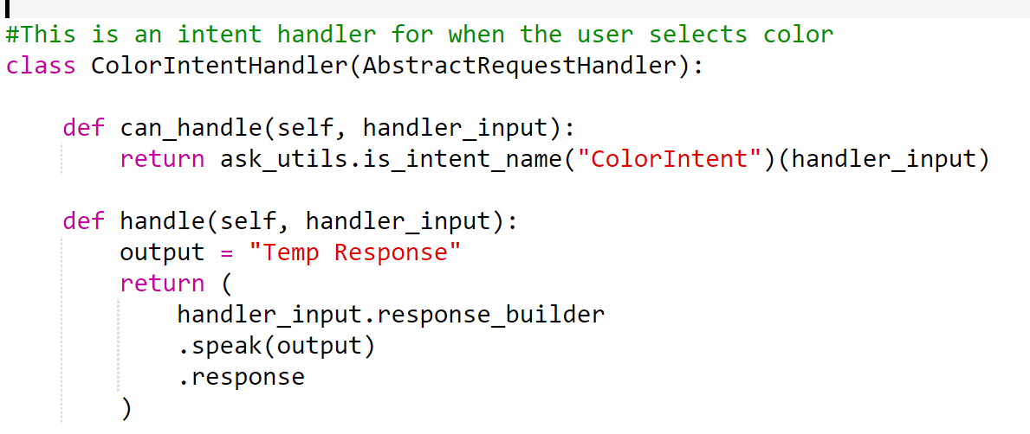
Coding Intents

Slide 29
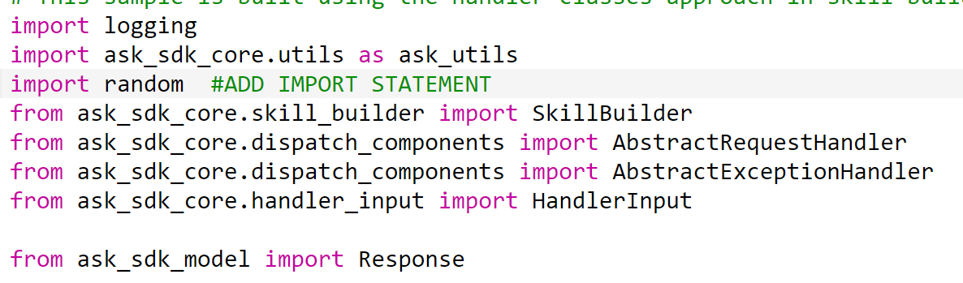
Import random

Slide 30
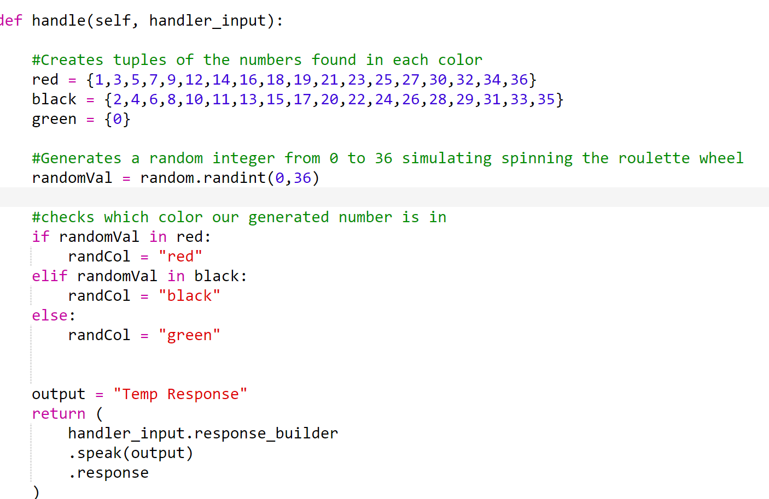
ColorIntent function
Simulates Roulette spin

Slide 31
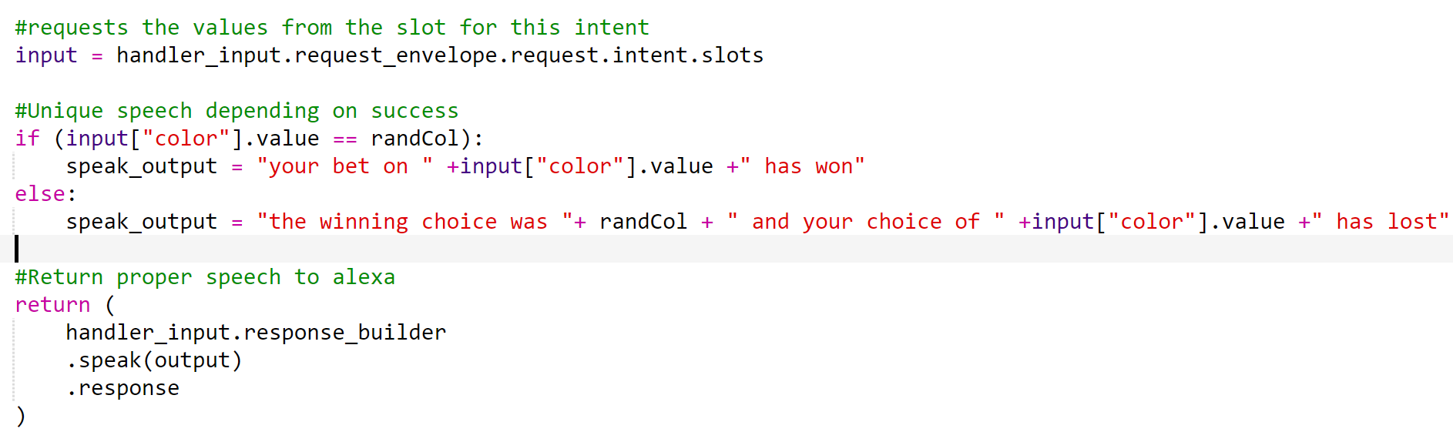
Add outputs

Slide 32
Flair and Style
Adding audio
Alexa skills kit sound library: https://developer.amazon.com/en-US/docs/alexa/custom-skills/ask-soundlibrary.html

Slide 33
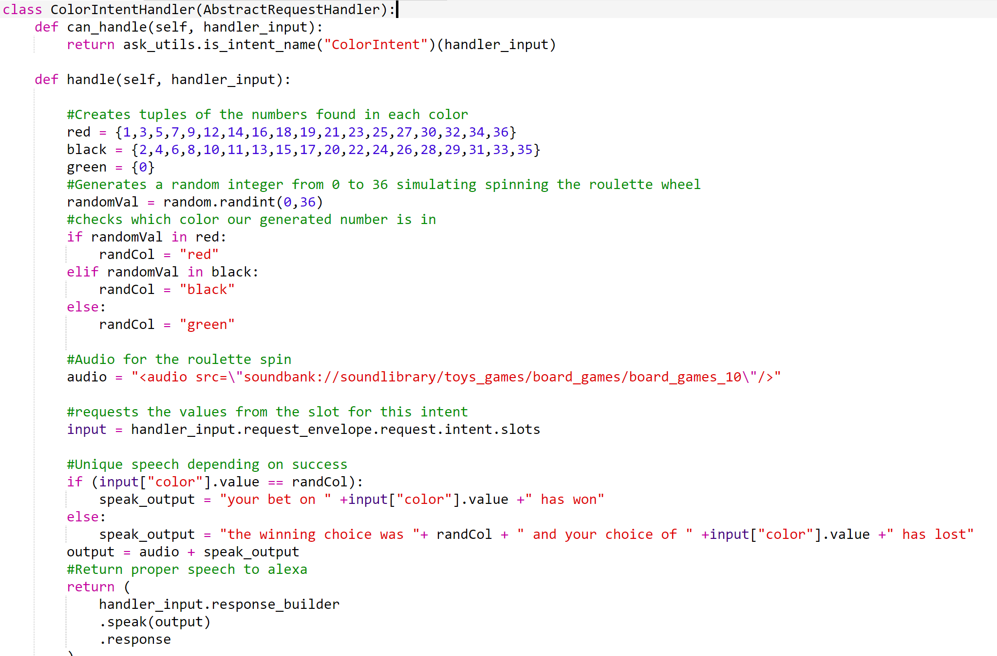

Slide 34
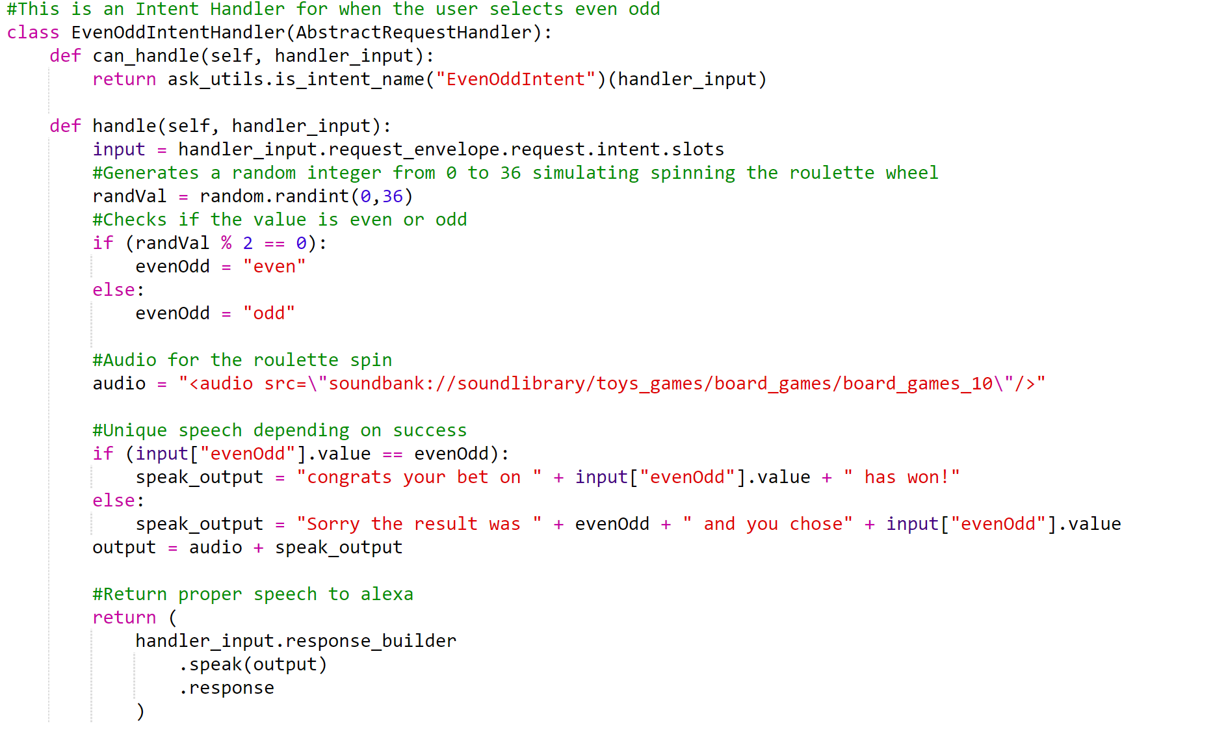

Slide 35
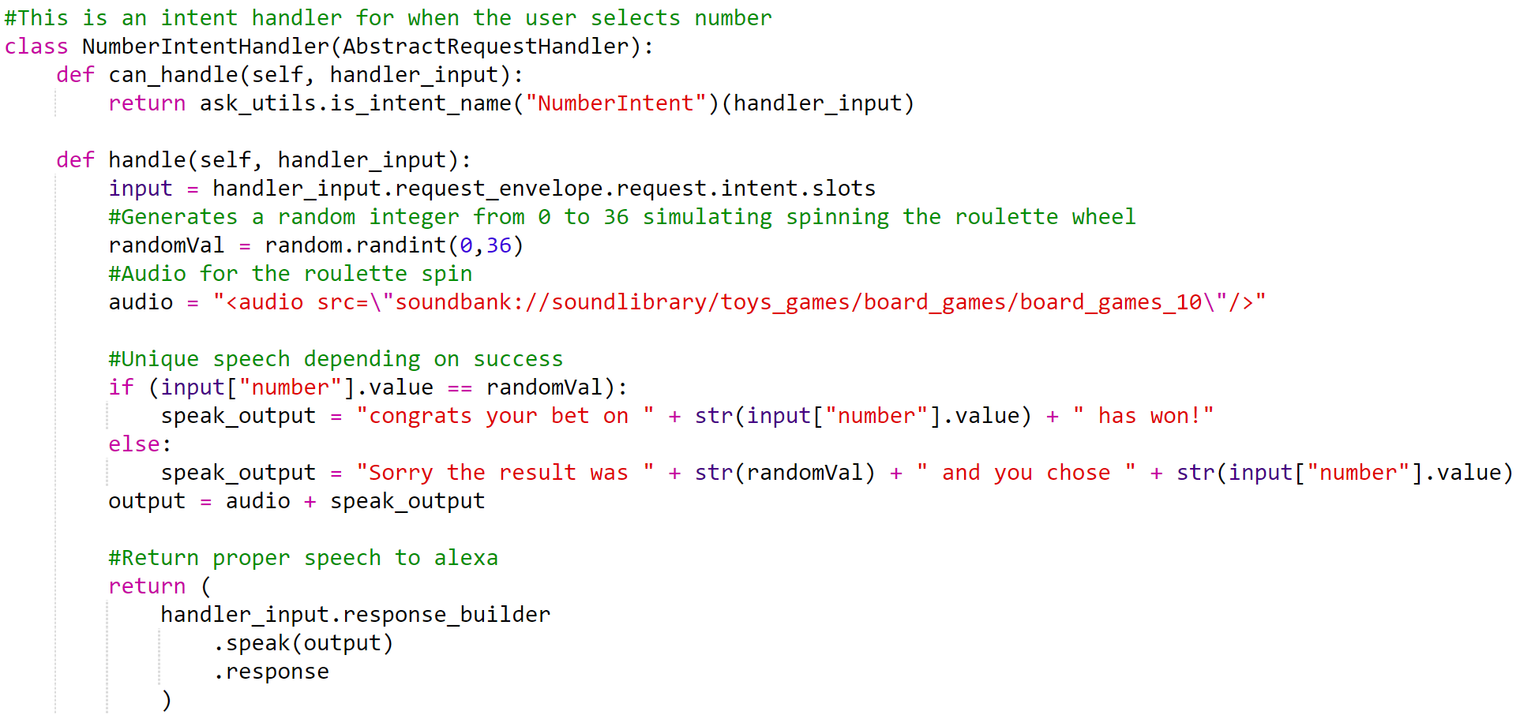

Slide 36
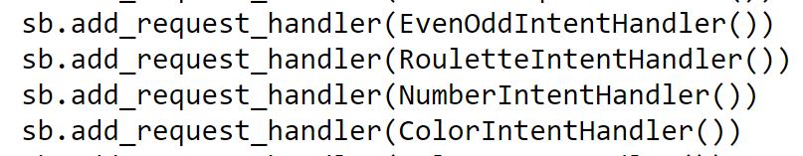
Dont Forget!
Add each handler to SkillBuilder at the bottom of the script
Save and Deploy

Slide 37
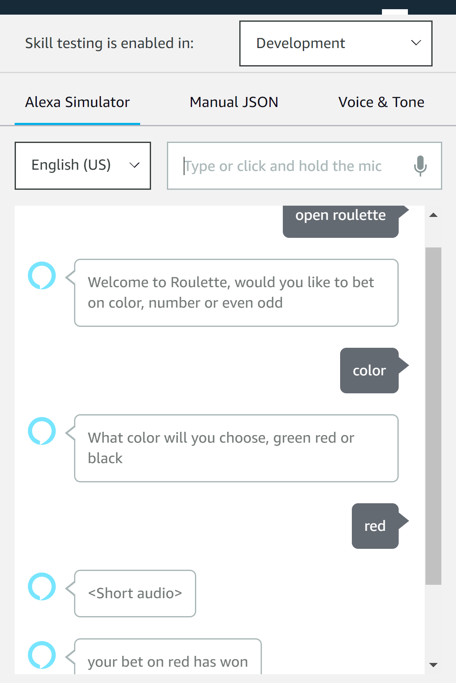


Test! Test! Test!

Slide 38
Further Exploration
Check out Alexa Skills Kit Official Site:
https://developer.amazon.com/en-US/alexa/alexa-skills-kit

